Slide 1
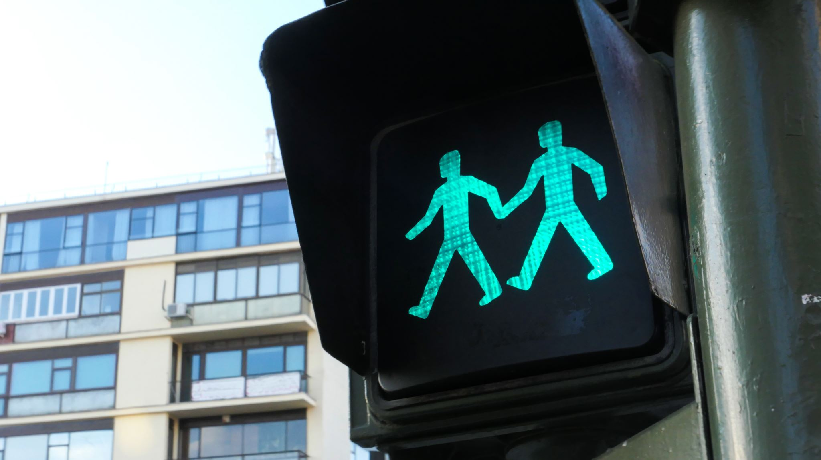
Traffic Signs

Slide 2

Discover Dataset
Now, What We Will Do

Slide 3
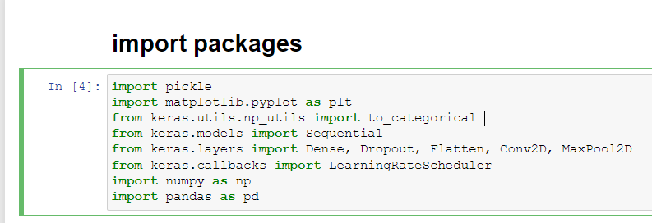
First We Will Import Somes Of Library To used it When We Work On Dataset
import pickle we used it to load dataset
import matplotlib.pyplot we used it for creating interactive visualizations
import to_categorical return dataset in vector
import Sequential we used to allow us to specify a neural network, precisely, sequential: from input to output, passing through a series of hidden layers, one after the other
import Dense, Dropout, Flatten, Conv2D, MaxPool2D to evaluate CNN
import LearningRateScheduler to get adapter (increase epochs, learning rate changes
import numpy It provides a multidimensional array object
import pandas used to analyze big data

Slide 4
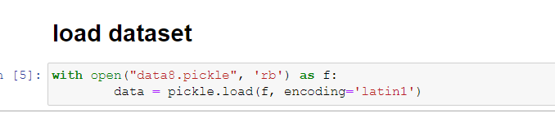
2. We Will Go To Load Dataset To Work On It:
1. use statement With calls 2 built-in methods (exit) and (enter) to loop on dataset
2. use function open() to read data from file
3. use pickle.load to load dataset in new label and use (encoding='latin1’)
because it allows you to import the data directly
Now, we will go to discover the dataset in order to know what is consists of

Slide 5
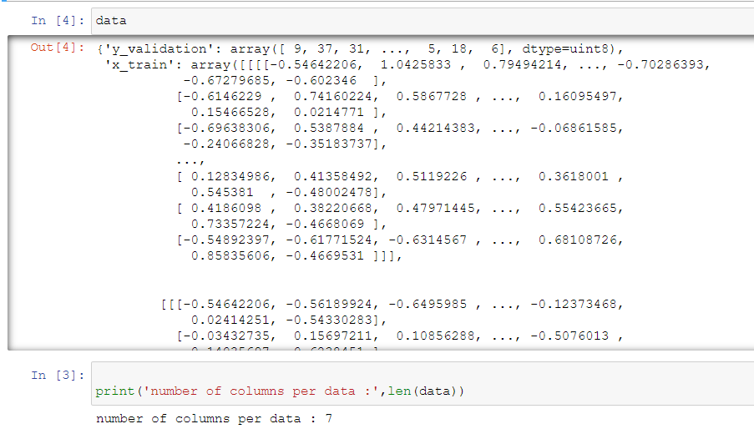
3. third, when we discover dataset, we found that dataset is consists of 7 columns

Slide 6

Prepare To
Discover Dataset

Slide 7
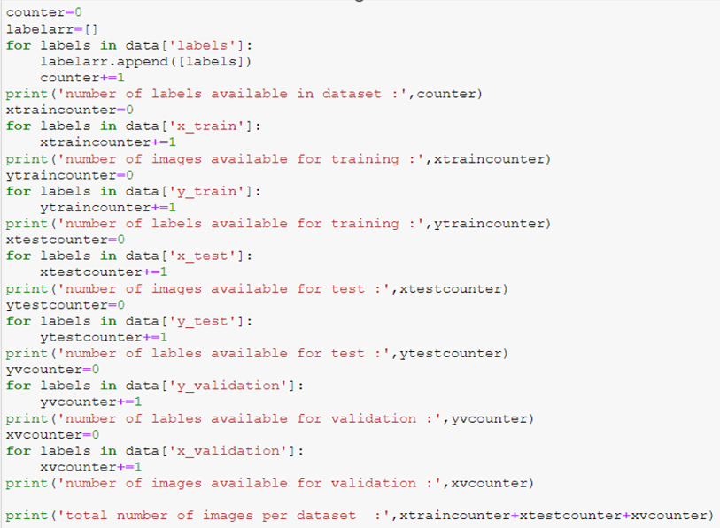
4. In This Step We Will
Make Data Analysis

Slide 8
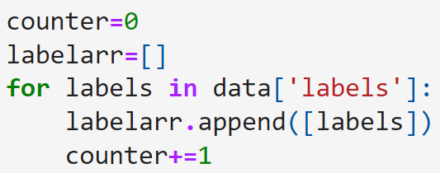
4. In This Step We Will train dataset and make Some Of Operation On Dataset
1. we will loop on labels column and append it in new array to know the number of labels in dataset
2.in this step we will divide
dataset in some category
3. laterly , we will return the total
image available in dataset by
sum(x_train ,x_test,x_validation)

Slide 9
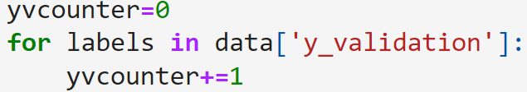
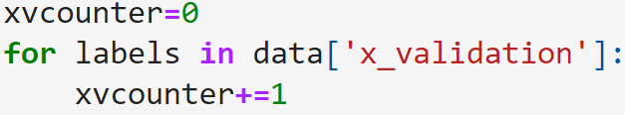
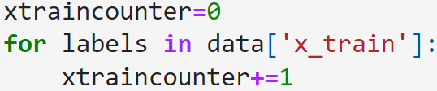
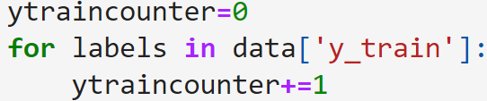
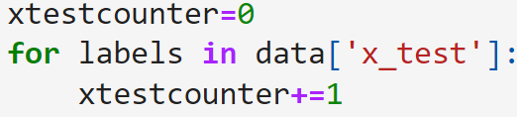
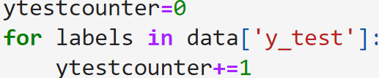
test data to return number of image that is ready to test in (x_test and y_test)
validation data to return number of image that is ready to validate in (x_validation and y_validation)
train data to return number of image that is ready to train in (x_train and y_train)

Slide 10
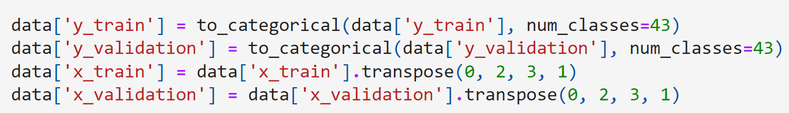
5. In this step we will prepare y_train , y_validation and x_train , x_validation
1. in y_train and validation we will use
library to_categorical to turn column to
vector by give it column name and
number of classes
2. in x_train and validation we will use
transpose to moving rows data to columns and columns data to rows
3. when we finished , we made
multiplication to make it in one data to
enter it on the model

Slide 11
Visualization
Make some plots on the dataset

Slide 12
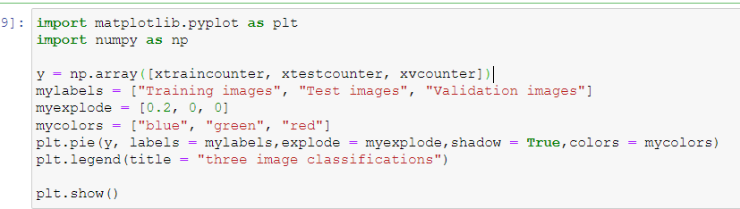
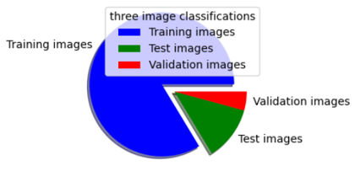
6. Now We Will Make Visualization About Dataset
1. create array that content x_train ,x_test and x_validation
2. create list that will content traning_images , test_images and validation_images
and create the same list for the color to show the percentage for everyone
3. use matplotlib to create pie chart for this columns and use plt.legend to make title to this

Slide 13
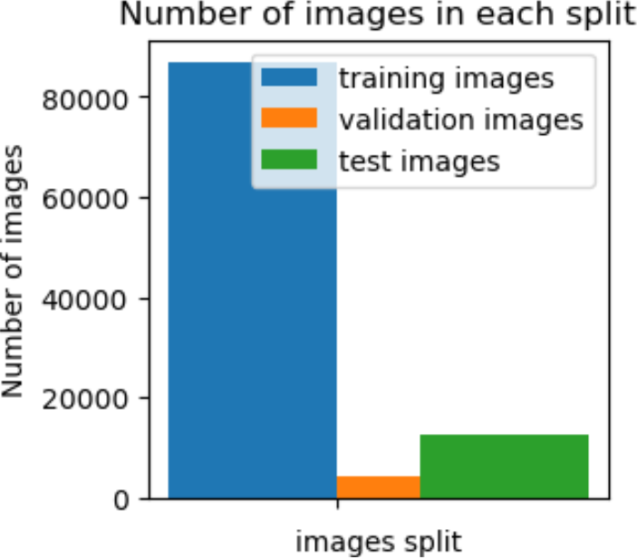
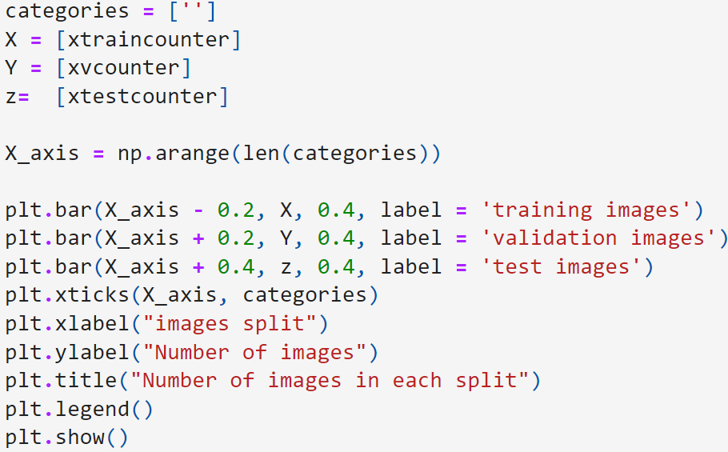
7. In this step we Will Show percentage on table bar
1. use numpy.arange() to arrange categories
because we will use it on bar
2. use plt.bar() give it categories arranged and
direction that you want to draw on it
3. create table demo to show percentage on it

Slide 14

Implement Model

Slide 15
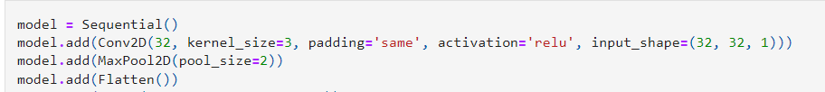
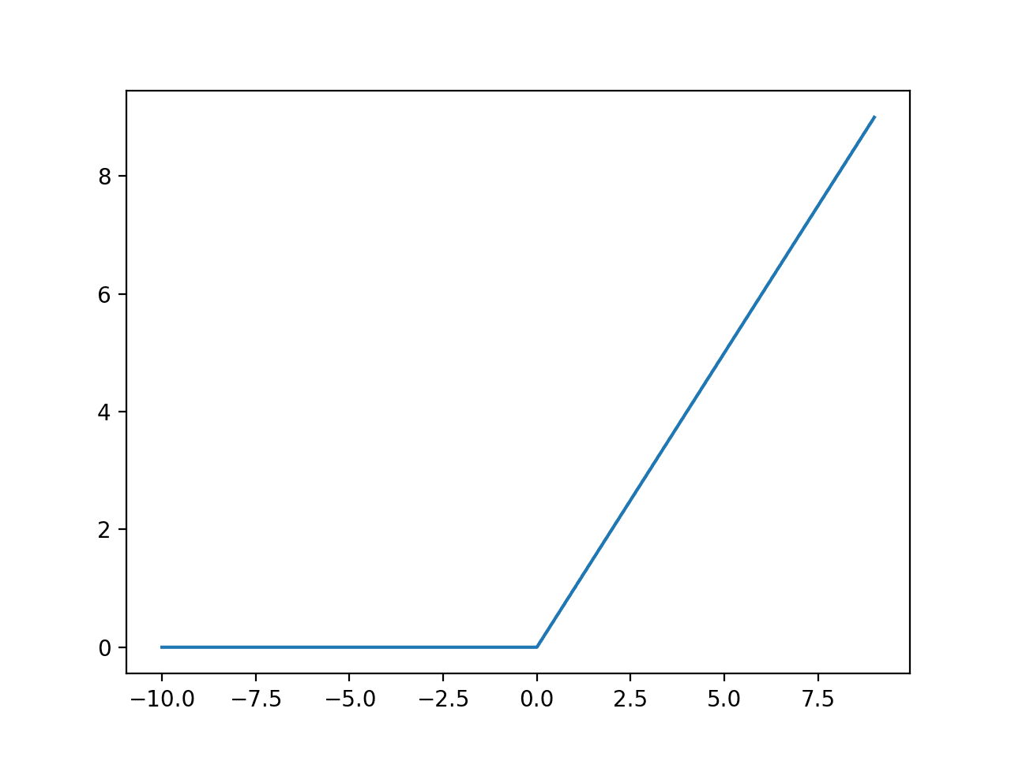
At first we used the sequential model allows us to specify a neural network, precisely, sequential: from input to output, passing through a series of hidden layers, one after the other.
conv2D : this layer creates a convolution kernel that is convolved with the layer input to produce a tensor of outputs.
Relu activation function
Actually, We evaluate CNN to generate our model by using Conv2D and MaxPool2D , 32 represent to filters ,using kernel_size of 3 while 3 represents the channels we slide a 3x3 matrix(comes from kernel size) , we use relu in activation function that will output the input directly if it is positive, otherwise, it will output zero ,when I write padding is same that mean output volume size matches input volume size , input_shape that responsible for (32)height and (32)width and (1)for channels ,pool size is 2 that will reduce the spatial dimensions of the output volume .

Slide 16
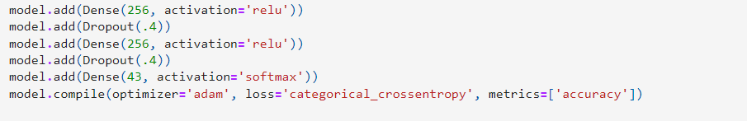
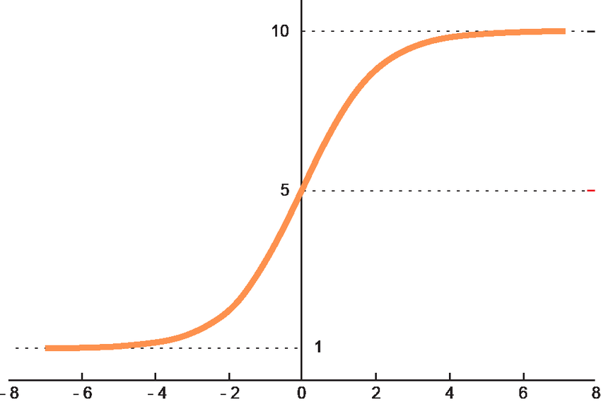
Using Flatten layer to convert multidimensional input to one dimensional
On the other hand ,we have 3 layers that’s have 256 of neurons that also have relu activation function .
Dropout layer to prevent overfitting
Second , we compilation the model after writing the layers in a model and before training starts by using adam optimizer that is extended version of stochastic gradient descent to adapt to our dataset, use categorical_crossentropy Because our dataset have many type of images not binary classes
Softmax, We will train a network to output a probability over the C classes for each image. It is used for multi-class classification.
Softmax activation function

Slide 17
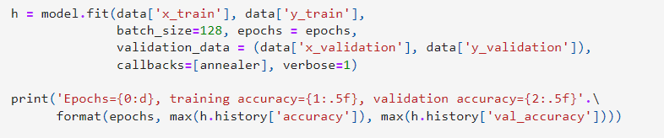
Then we fit the model to run it on the dataset
We put the specific parameters to model to reach the highest accuracy by using train and validation
When we run the model, the accuracy is 93%
batch_size, number of samples to work through before updating the internal model parameters.
epochs, number times that the learning algorithm will work through the entire training dataset.
verbose = 1, which includes both progress bar and one line per epoch

Slide 18
Visualization
Make some plots on the dataset

Slide 19
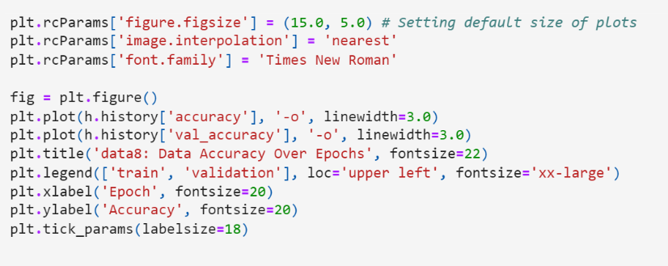
Here we using matplot.pyplot to show some plots on our dataset and increase our performance
First ,we setting the default size of plots and select the font of plots
Second, we determination the x and y axis that’s epochs on x-axis and accuracy on y-axis

Slide 20
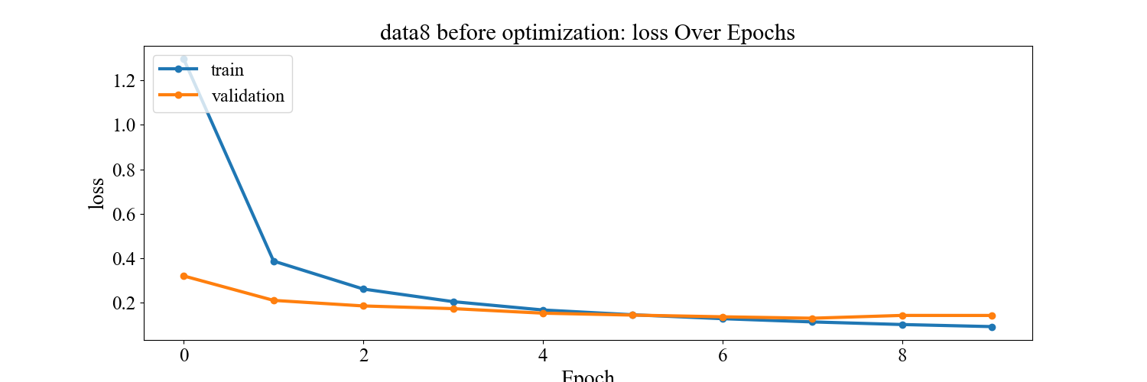
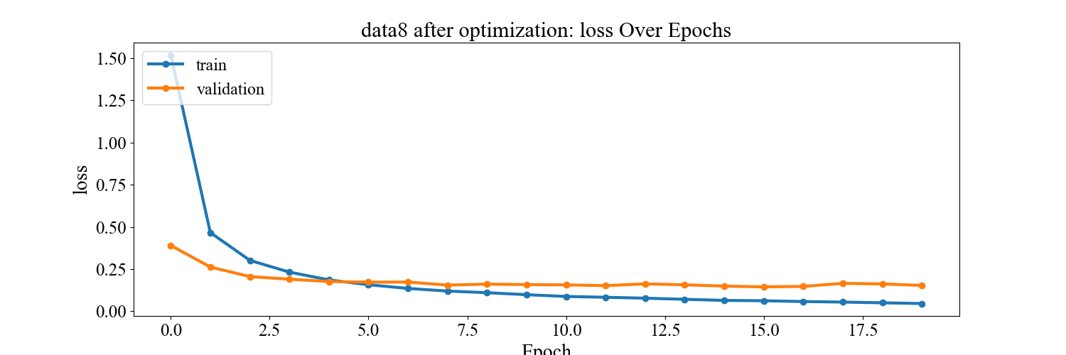
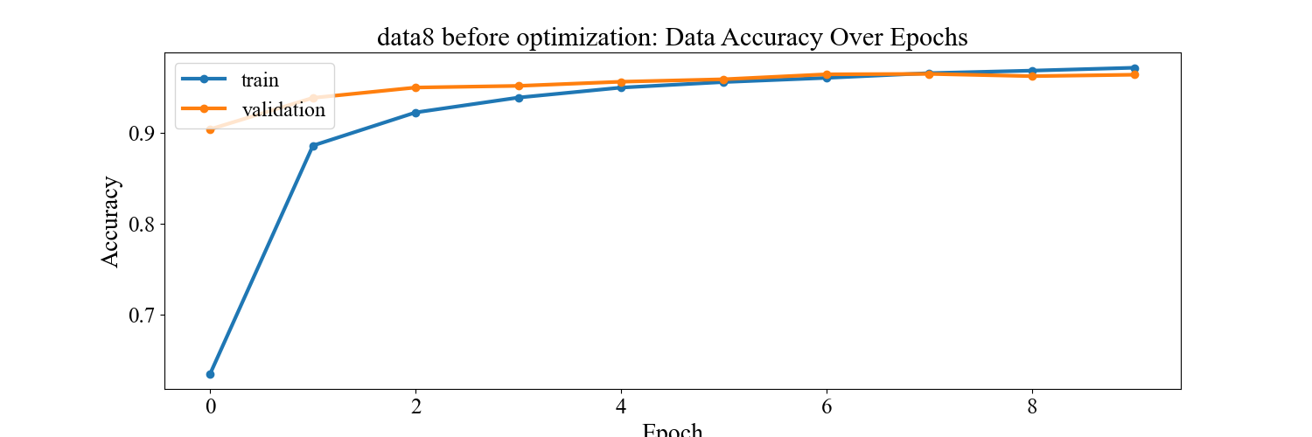
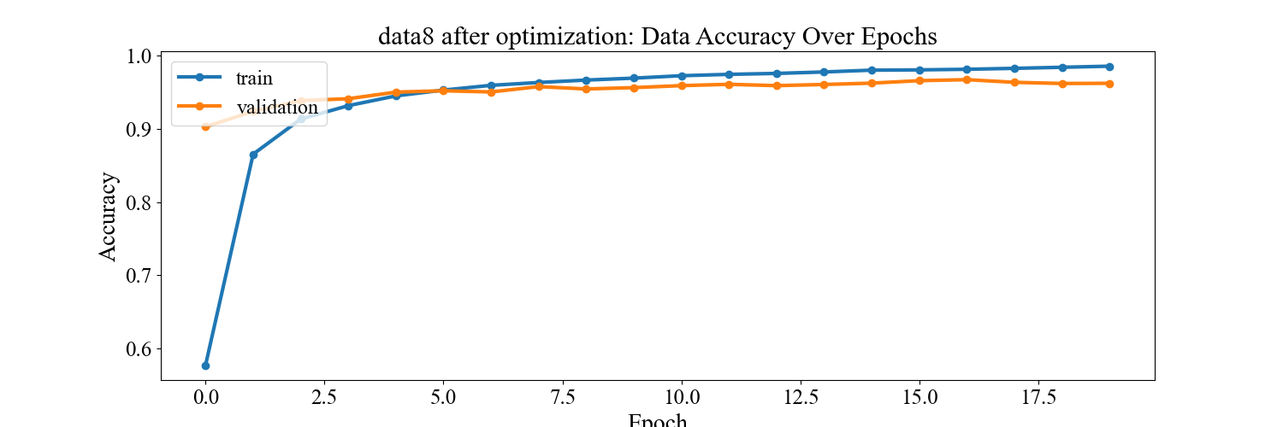
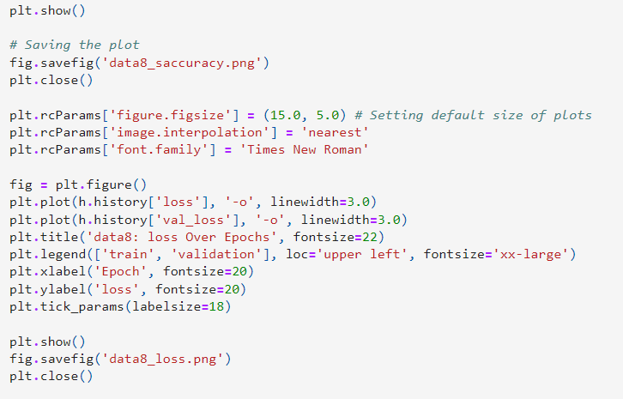
We use show function to show our plot and save the plots in data8_saccuracy.png that show model performance

Slide 21
Evaluate the model
Evaluate the model to reach 97%

Slide 22
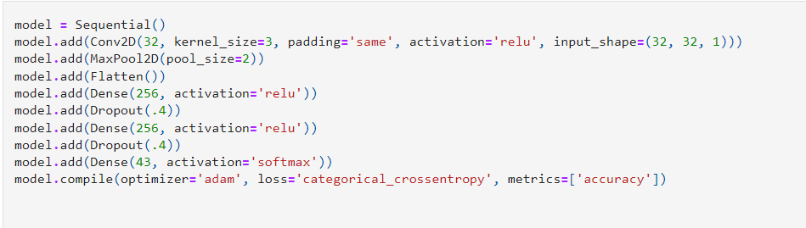
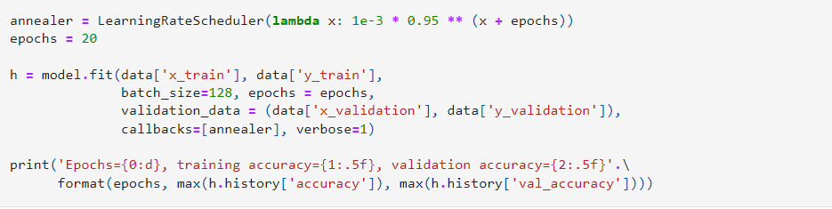
After we reach the accuracy to 93 % we wanna high the accuracy and optimize the model so increase the epochs from 10 to 20 to test the model

Slide 23

Test Model

Slide 24
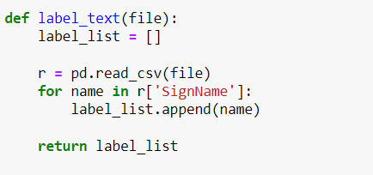
Here we load the model after implementing and saved it instead of running the model every time. We use it to save the time.
We have to transpose ‘x_test’ to make it vector to reach to shape that can be able to multiply with the matrix.
This function is used to read the csv file and loop in the file at column SignName and append this data to the list we have declared above label_list

Slide 25
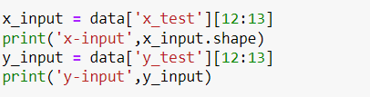

Here we invoke the function that we declared and take the csv file that we want to read and store it in variable ‘labels’
1’st step, Then we access the ‘x_test’ column from file data at index 12 and stroe it in ‘x_input’.
And print the shape of this image at index 12
2’nd step, we access the ‘y_test’ and print the label of the same index of ‘x_input’
number of images.
Height
Width
number of channels.
Finally, we print the label of this image then the label =7

Slide 26
Visualization
Visualization
Visualization
Make some plots on the dataset
Make some plots on the dataset
Make some plots on the dataset

Slide 27
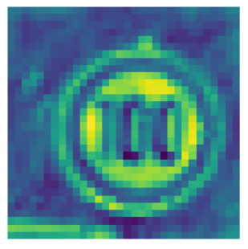
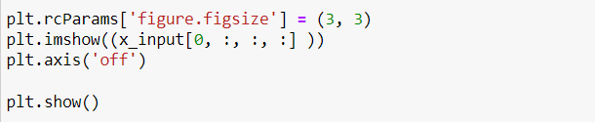
Here we using matplot.pyplot to show some plots on our dataset.
Then we display the image of width and height 3 and width 3.
Then we use plt.axis(‘off’) to remove the x-axis and y-axis
Finally ,we display the image.

Slide 28
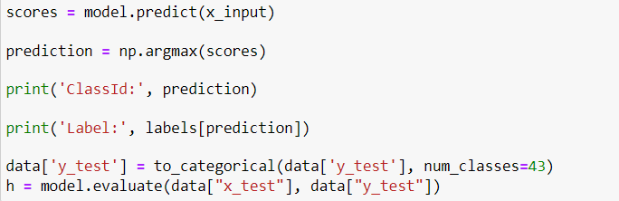
Display the accuracy
We store the predict of ‘x_input’ and store it in variable scores
Using argmax of scores to select the maximum value of scores(probability)
Print the ClassId and its Label
Finally , we print the accuracy

Slide 29



THANK YOU!

